Slide 1

4
Vector geometry

Slide 2
Chapter Outline
4.1. Vectors and Lines
4.2. Projections and Planes
4.3. More on the Cross Product
4.4. Linear Operations on ○³
4.5. An application to Computer Graphics

Slide 3
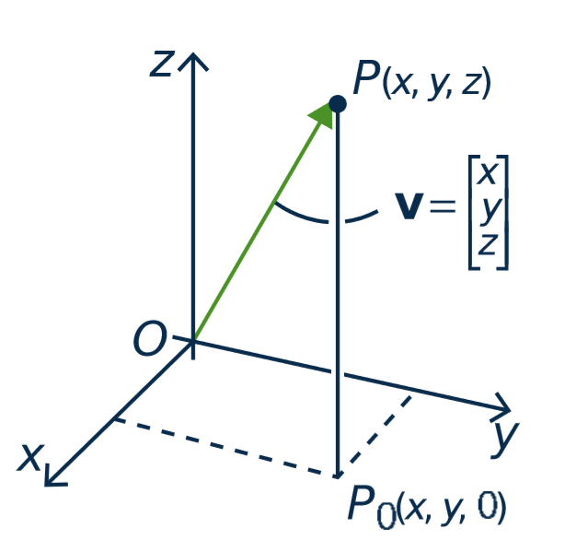
4.1. Vectors and Lines
point P(x, y, z)
Vectors in ○³
The terms vector and point
are interchangeable.
vector v

Slide 4
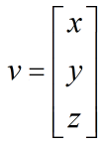

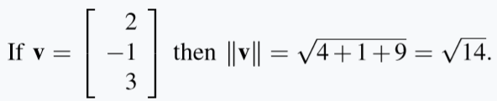
Vectors in ○³
Length.
If then
Ex.

Slide 5

True or false?
If $\left\|v\right\|$ = 3, then $\left\|−2v\right\|$ = -6.
If $\left\|v\right\|$ = 0, then $v$ is zero vector.
-2v
v

Slide 6
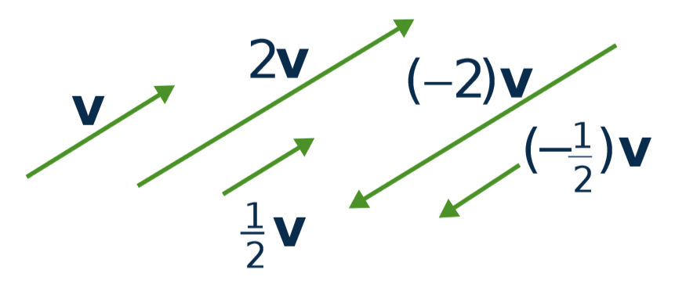
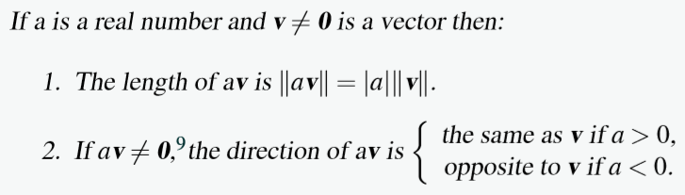
Scalar Multiple Law

Slide 7
Equality
Let v ≠ 0 and w ≠ 0 be vectors in R³.
Then v = w if and only if v and w have the same direction and the same length.
➔ The same geometric vector can be positioned anywhere in space.
•
•
v
w
•
•

Slide 8
Parallel vectors
Two nonzero vectors are called parallel if they have the same or opposite direction.
v and w are parallel ⇔ v = kw for some scalar k
v
-2v

Slide 9
The Parallelogram Law
v
v + w ⬅ first v then w
w
v + w = w + v

Slide 10
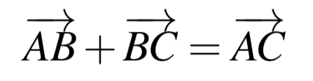
Tip-to-tail rule
B
C
A

Slide 11
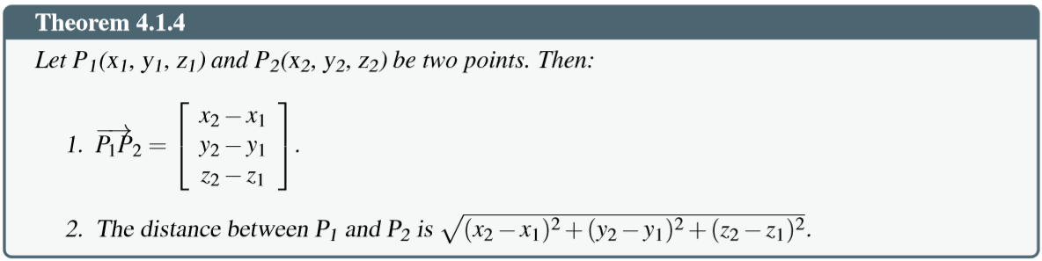
Distance between two points

Slide 12
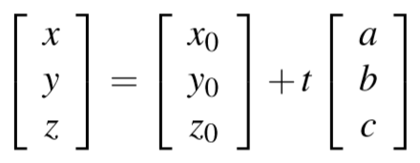
Lines in Space
Given the point P₀ (with vector p₀) and the direction vector d ≠ 0.
Then line parallel to d through the point P₀ is given by:
p = p₀ + td,
(t is any number)

Slide 13
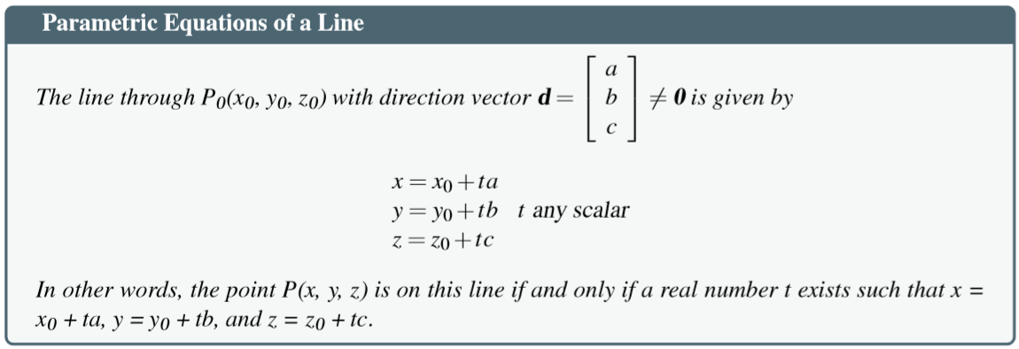
Lines in Space

Slide 14
Lines in Space
Ex. Given P₀()

Slide 15
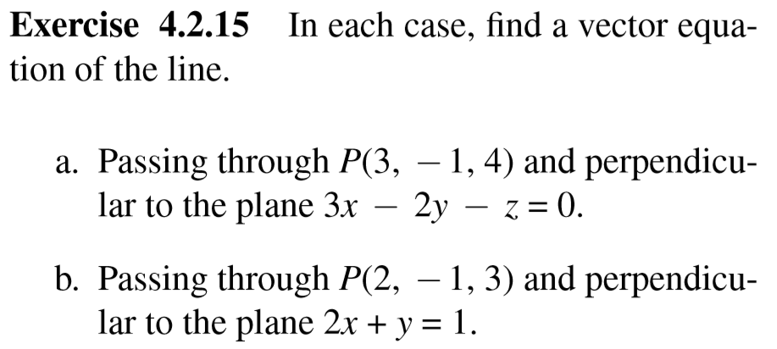
Notes:
Perpendicular: vuông góc

Slide 16
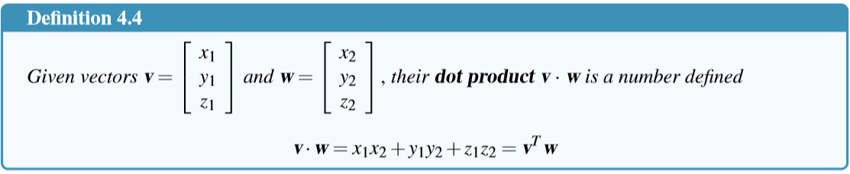
4.2 Projections and Planes
The Dot Product

Slide 17
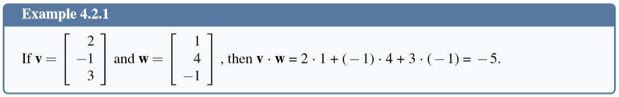
The Dot Product

Slide 18
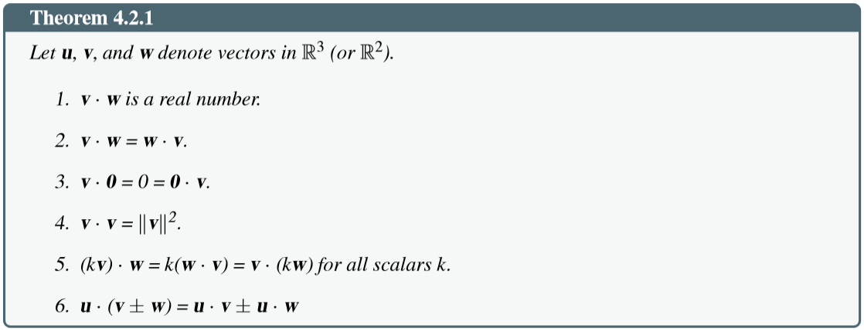
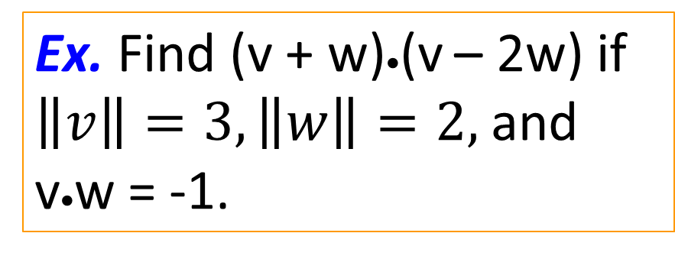
Properties of dot product
Ex. Find (v + w)•(v – 2w) if $\left\|v\right\|=3, \left\|w\right\|=2,$and v•w = -1.

Slide 19
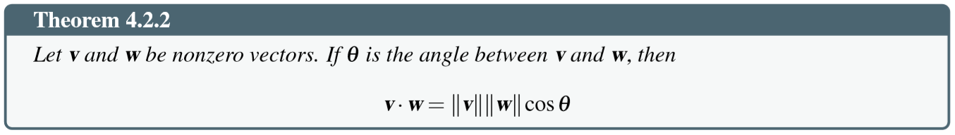
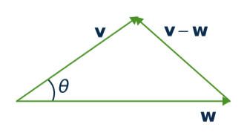
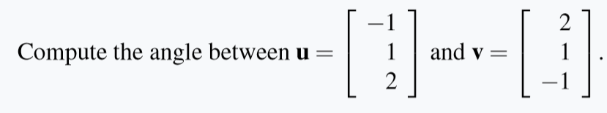
Angles between vectors
Example.

Slide 20
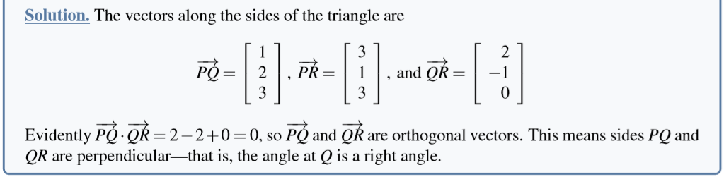
Orthogonality
Two vectors v and w are said to be orthogonal if
v • w = 0
Notes:
Orthogonal: trực giao (vg)

Slide 21
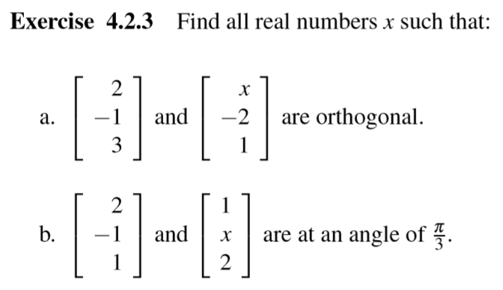

Slide 22
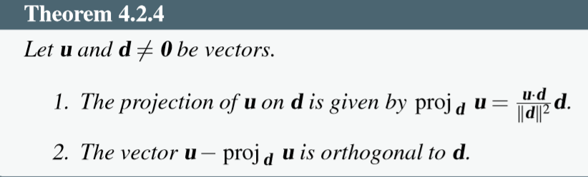
Projection
u
u – v
1. v ⁄ d
2. u – v ⊥ d
•
d
v

Slide 23
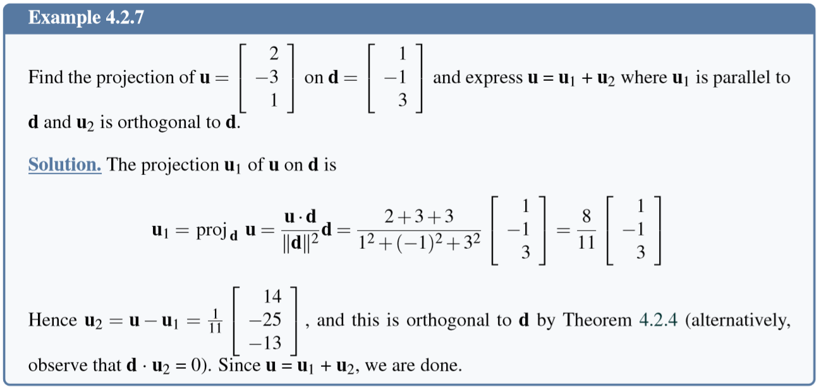
Projection

Slide 24
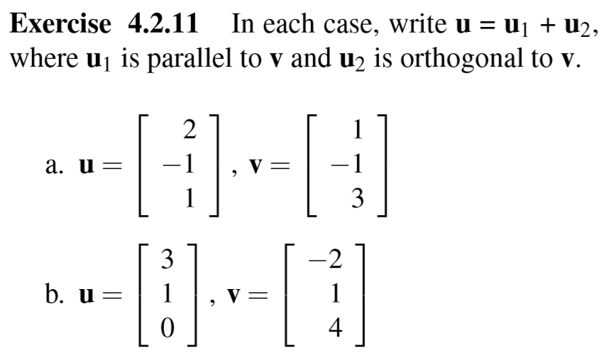

Slide 25
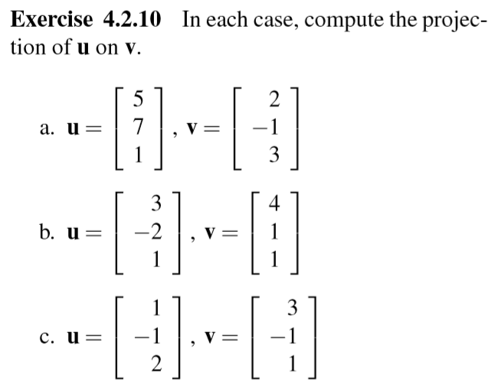

Slide 26
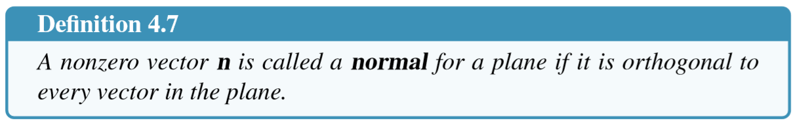
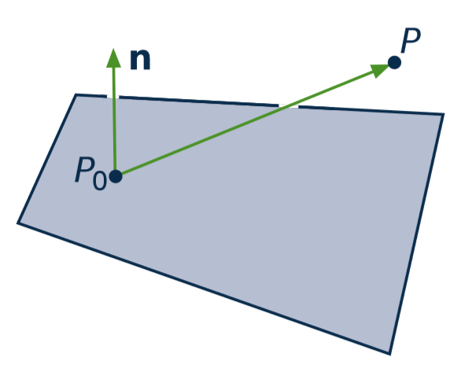


Planes
Notes:
Normal: vector pháp tuyến

Slide 27
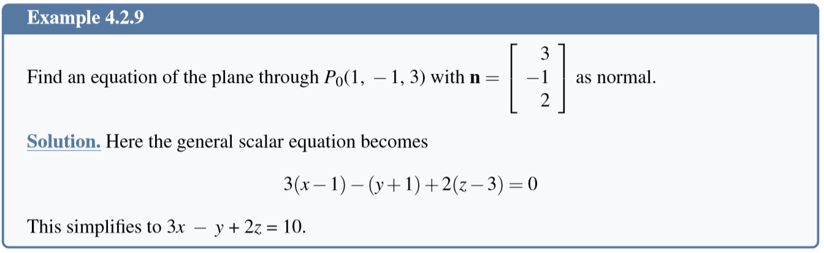
Equation of a Plane

Slide 28
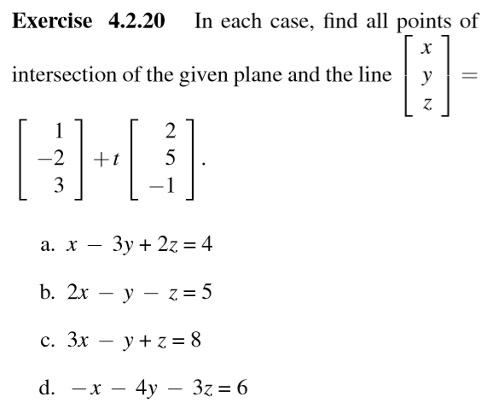

Slide 29
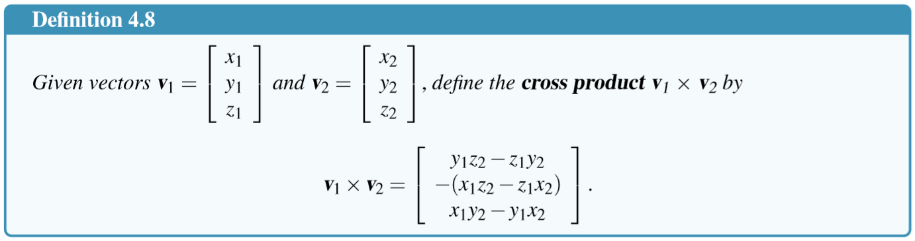
The Cross Product

Slide 30
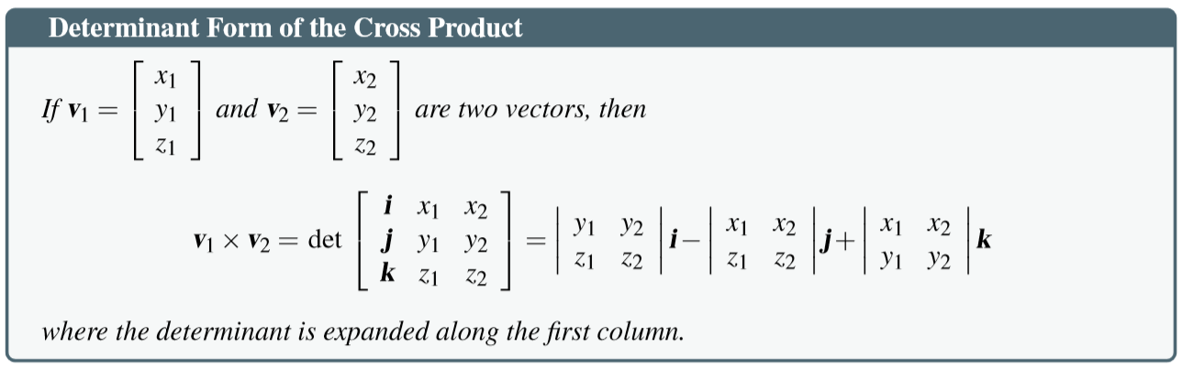

Slide 31
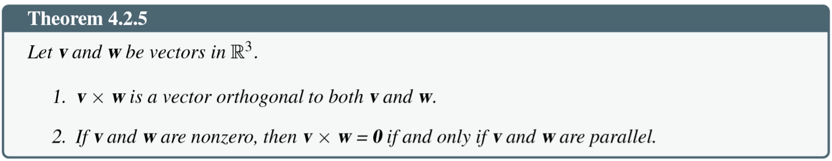
Properties of cross product

Slide 32
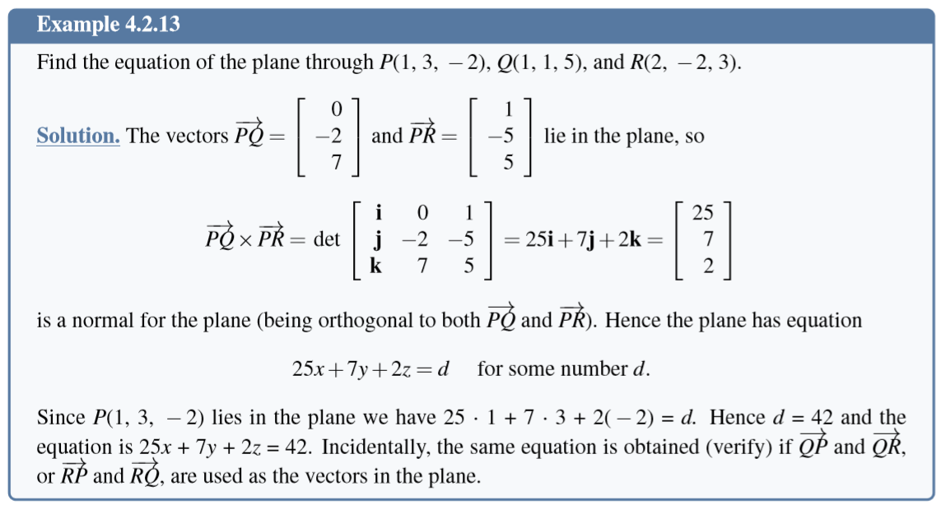

Slide 33
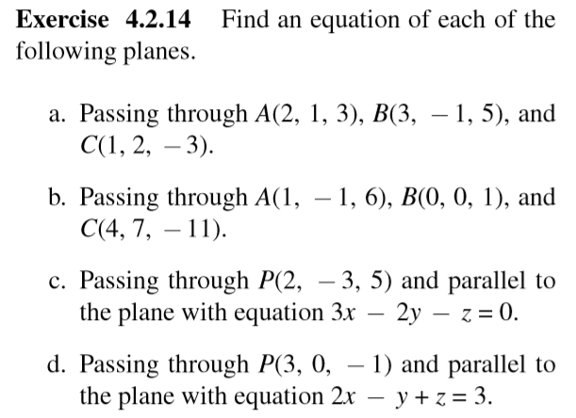
Exercises – equations of planes

Slide 34
4.3 More on Cross Product
Read yourself pages

Slide 35
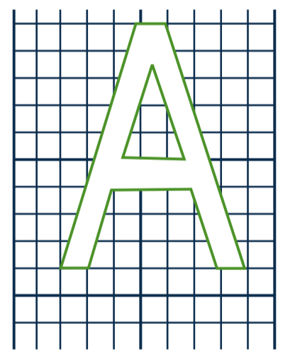
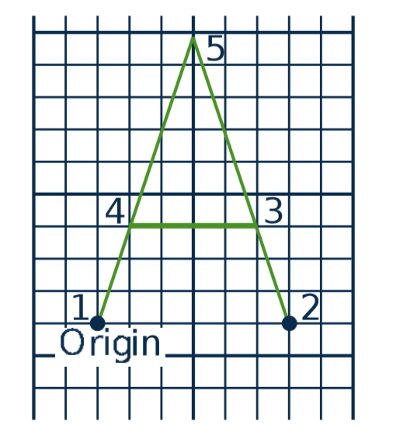
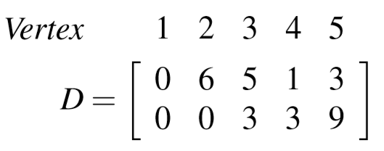
4.5 An application in Computer Graphics
Data matrix D

Slide 36
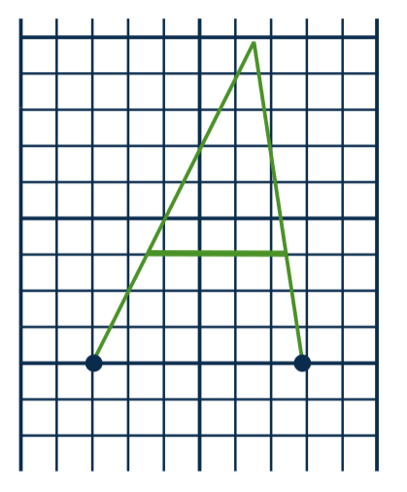
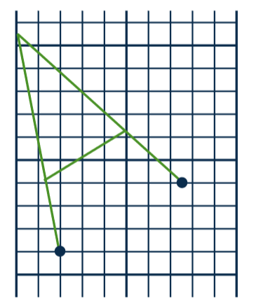
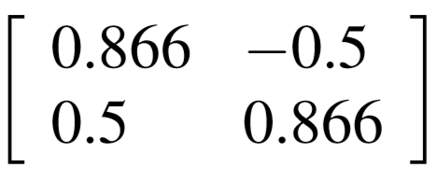
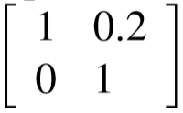
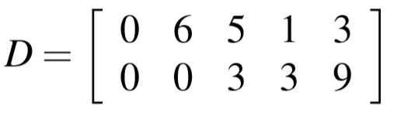


How to change image?
C
D
C

Slide 37
Computer graphics
Image ➔ matrix D
Matrices of transformations A₁, A₂, ..., A_{n}
Compute A_{n}...A₃A₂A₁D
3rd transformation
1st transformation
Data matrix
n^{th} transformation
2nd transformation

Slide 38
Some common transformations and their matrices
Reﬂections and Projections
Rotations
Translations

Slide 39
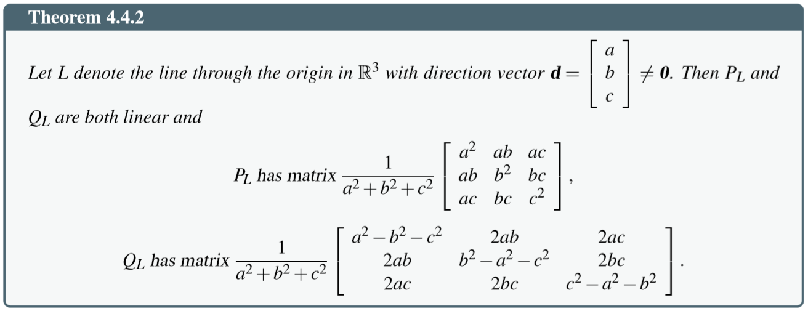
Matrices of Reﬂections and Projections
Reﬂections and Projections

Slide 40
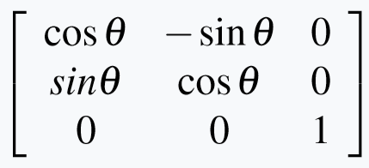
Matrices of Rotations

Slide 41
Matrices of Translations
Need a clever way to give these matrices (Read yourself in the text book)

Slide 42
Summary
4.1. Vectors and Lines
4.2. Projections and Planes
4.3. More on the Cross Product
4.4. Linear Operations on ○³
4.5. An application to Computer Graphics

